Slide 1

Towards IoT and ML Driven Cardiac Status Prediction System
Group - C
Samsun Nahar - 011152117
Shaira Tabassum - 011152129
Md Ittahad Uz Zaman - 011152134
Ashikur Rahaman - 011152135
Md Sabbir Ullah - 011152144
Supervisor: Dr. A.K.M. Muzahidul Islam

Slide 2
Outline
Introduction
Problem definition
Motivation
Existing Work
Work in Progress
Future work
Outcome of the project

Slide 3

Introduction
Deaths due to heart disease occur before the patient gets any treatment
Patients could not have any clue of their heart condition beforehand
Collecting the data of patients having heart condition with IoT devices
Process the collected data with ML algorithm and check the results
We develop a prototype to collect data from human body
Notes:
Most deaths of heart disease before the patient gets any treatment
Patients could not have any clue of their heart condition beforehand
Gets no time to take preventive actions if disaster happens
Collecting the data of patients heart condition with IoT devices
Keep the data updated with the patients regular checkups
Forming appropriate models for predicting heart condition
Process the collected data with ML algorithm and check the results
Develop a prototype

Slide 4
Problem Definition
Cardiovascular and Coronary Artery diseases are two major causes of mortality now a days.
The effect is higher in urban areas
Available treatments are quite costly.
Major cause of death in Bangladesh
Statistics of 1986
Communicable Disease | 52 %
Non Communicable Disease | 8 %
Statistics of 2014
Non Communicable Disease | 59 %
Deaths due to CVD | 17 %
https://www.banglajol.info/index.php/BHJ/article/view/32379
Notes:
Reason of death has dramatically shifted from communicable to non-communicable diseases.
Eikhane kintu sob death er statistics

Slide 5
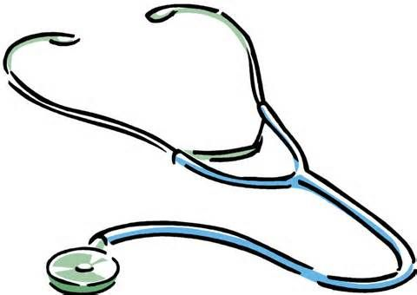
Motivation
Cardiac diseases are highly prevalent in Bangladesh
People hardly follow regular checkup
People taking drug therapy to prevent cardiac issues is negligible
People getting heart attack is rising as well the death rate
Bangladesh Ranked 104 in the world with 14.31 % of total death in 2017
https://www.worldlifeexpectancy.com/bangladesh-coronary-heart-disease
Notes:
Cardiac diseases are highly prevalent in Bangladesh.
People hardly follow regular checkup.
Long term and slowly progressive diseases are so severe in future.
People are barely conscious and it results too critical in last.
People taking drug therapy to prevent cardiac issues is negligible.
According to WHO people taking drug therapy to prevent heart related disease is negligible.
Heart attack rising, death rate increasing.
Ranked 104 in the world with 14.31% of total death in 2017.

Slide 6
Existing work
Existing devices or circuit implementation
We-Care System
ECG signal analysis and feature extraction
BSN technology based health monitoring system
Non Invasive glucose and Cholesterol detection
Notes:
Focused on cardiac disease detection
Used pre-existing Machine Learning algorithm
Identified 12 parameters as standard
Calculate result based on parameters given
Manual data collection and feeding
We-Care System
We-Watch
Wristband
Web server
Web app

Slide 7
Existing parameter definition
Vital element of heart condition prediction
Blood pressure, ECG, Heart rate, Pulse rate, Blood glucose
Health monitoring and measurement system
ECG, Respiratory rate, EMG
Measuring physiological ECG data using MCU
Heart Rate, Heart Rate Variability

Slide 8
Our Approach

Slide 9
For our prototype we have selected 12 parameters
Age
Gender
Chest pain type
Resting blood pressure
Cholesterol
Fasting blood sugar
Resting ECG
Max heart rate
Exercise included angina
Old peak
Slope
CA
Manual Input
Collect through sensors
For future work

Slide 10
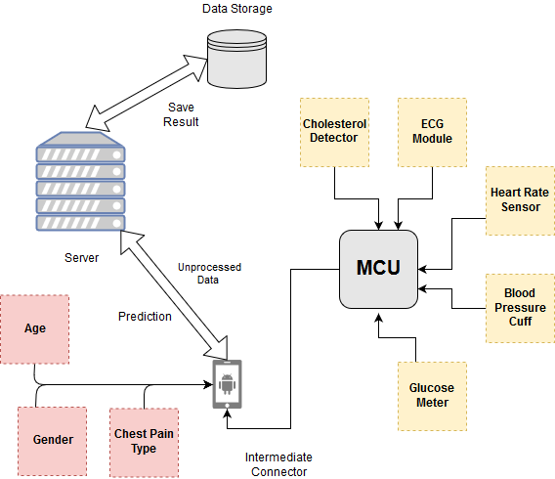
Proposed Prototype
Fig: Block diagram of Combined prototype of 4 parameters
Notes:
Now I will discuss the current status of our project.

Slide 11
Our Progress

Slide 12
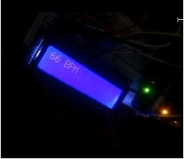
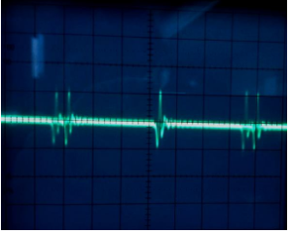
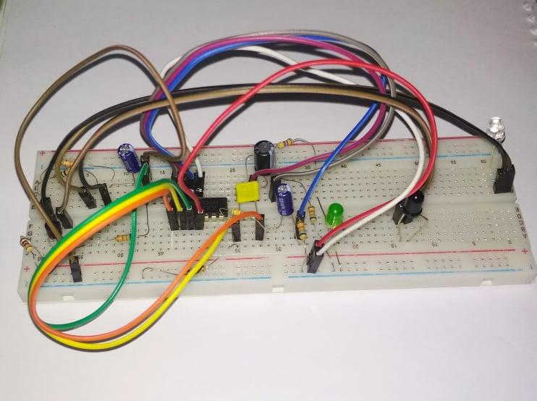
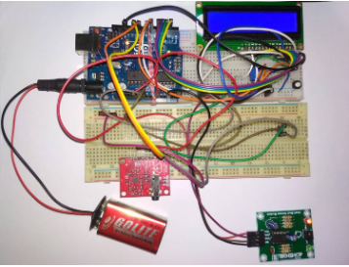
Fig: Heart rate sensor module
Fig: Output of ECG sensor module
Fig: Cholesterol measurement circuit
Fig: Combined circuit

Slide 13
Compliance with Standards

Slide 14
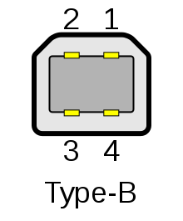
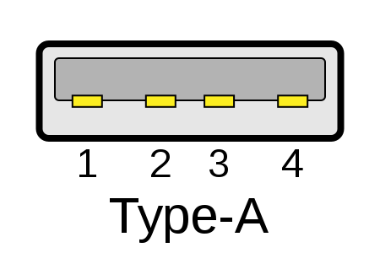
Wireless Connectivity
IEEE 802.15.6 Wireless Body Area Network (e.g. Bluetooth low energy)
IEEE 802.11 Wireless Networking - WiFi
Cable Connectors
USB 2.0 Cable Type A/B
Mini Jack (3.5 mm)
Pin
Interface
HTML, DOM, CSS
Notes:
https://en.wikipedia.org/wiki/IEEE_802.11 -----> WIFI
https://en.wikipedia.org/wiki/IEEE_802.15.6 -----> Body area network (Bluetooth)

Slide 15
Data Format
JSON-LD
ASCII
Programming Languages
Javascript
Python
Java

Slide 16
Impacts and Constraints

Slide 17

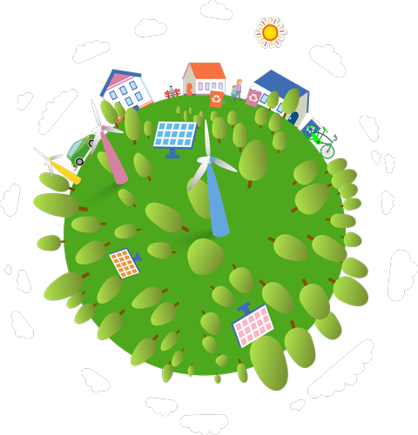
Economic Impact
Environmental Impact
Initially investment is high but will decrease if the H/W is combined together.
Health monitoring will be affordable to people if cost becomes less.
No effect on ecosystem or environment.

Slide 18
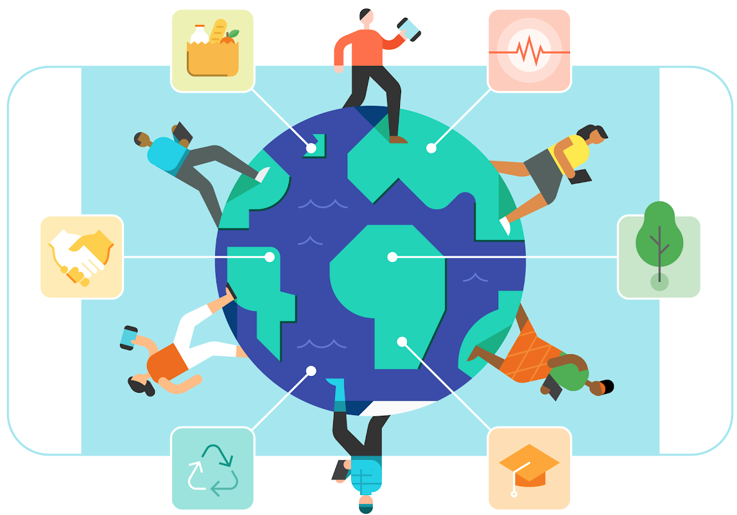
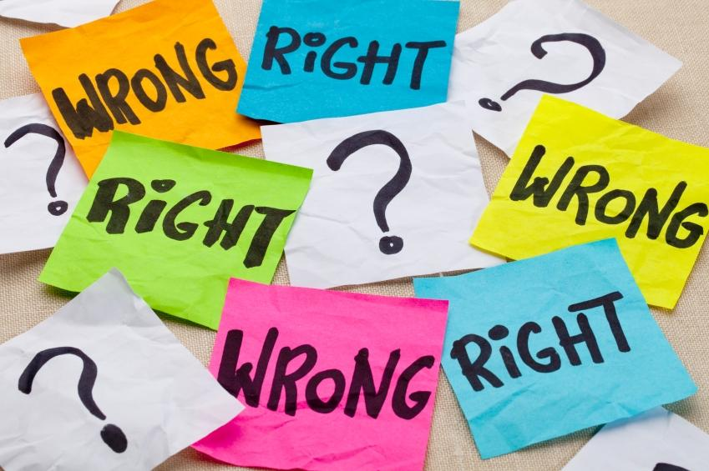
Social Impact
Ethical Impact
Disadvantaged people could be highly benefited.
No chance of attempting unfair means.
Acceptable in the society.

Slide 19


Health and Safety Impact
Political Impact
User authentication and data encryption will be applied to control the data manipulation.
Due to DC operated modules there is no adverse impact on health.
No law breaking issue.
Combined H/W prototype can be build in large scale and it would be cheap.

Slide 20
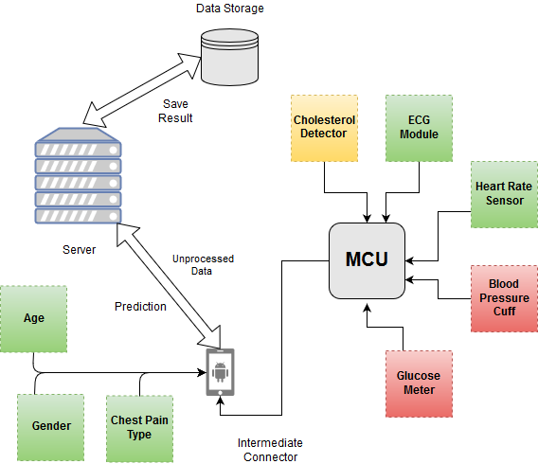
Fig: Our present status and future goals
Notes:
Now I will discuss the current status of our project.

Slide 21

Future work
Implement the remaining parameters.
Combine all the modules and circuits to implement a prototype.
Transferring the data of the combined prototype to an ML algorithm on the server using mobile device as intermediate gateway.
Visualize the prototypes output through an app.

Slide 22

Outcome of the Project
Combined prototype will be cost effective
User can easily monitor their health status
In long term patients will be benefited because they will be able to observe their health status.
Because of getting early health prediction people will be much more conscious about their well being.
With governments support it could be made affordable for all people
Notes:
All the users health data will be stored in the database with users consent.

Slide 23

Conclusion
Thus, this project will collect 8 types of data
IoT devices will have to be deployed to efficiently collect and send the data to the server.
The dataset then will have to be processed and analyzed to take vital decisions.
Status can be sent to patients for further inspection.

Slide 24
Reference
We-Care: An IoT-based Health Care System for Elderly People by S. Pinto, J. Cabral and T. Gomes
Ecg signal analysis and arrhythmia detection on iot wearable medical devices by D. Azariadi, V. Tsoutsouras, S. Xydis, and D. Soudris
Highly Secured IoT Based Health Care System for Elderly People using Body Sensor Network by Snehal Sanjay Kale and D. S. Bhagwat
Non-invasive cholesterol meter using Near Infrared sensor by I.M.M. Yusoff ; R. Yahya ; W.R.W. Omar ; L.C. Ku
The iot-based heart disease monitoring system for pervasive healthcare service by C. Li, X. Hu, and L. Zhang

Slide 25
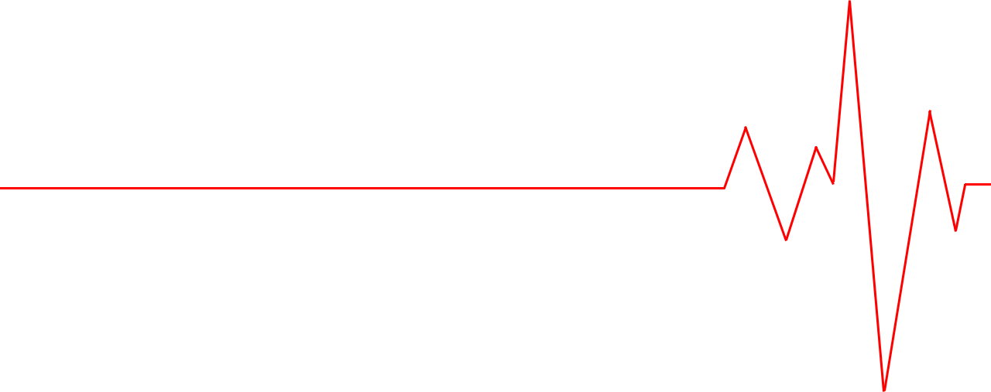
Any Questions?

